Slide 1
Graph and Tree
Hyerim Bae
Department of Industrial Engineering, Pusan National University
hrbae@pusan.ac.kr

Slide 2
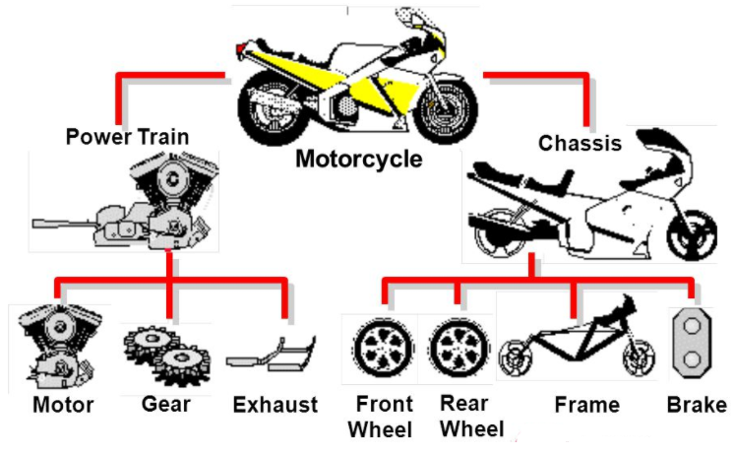
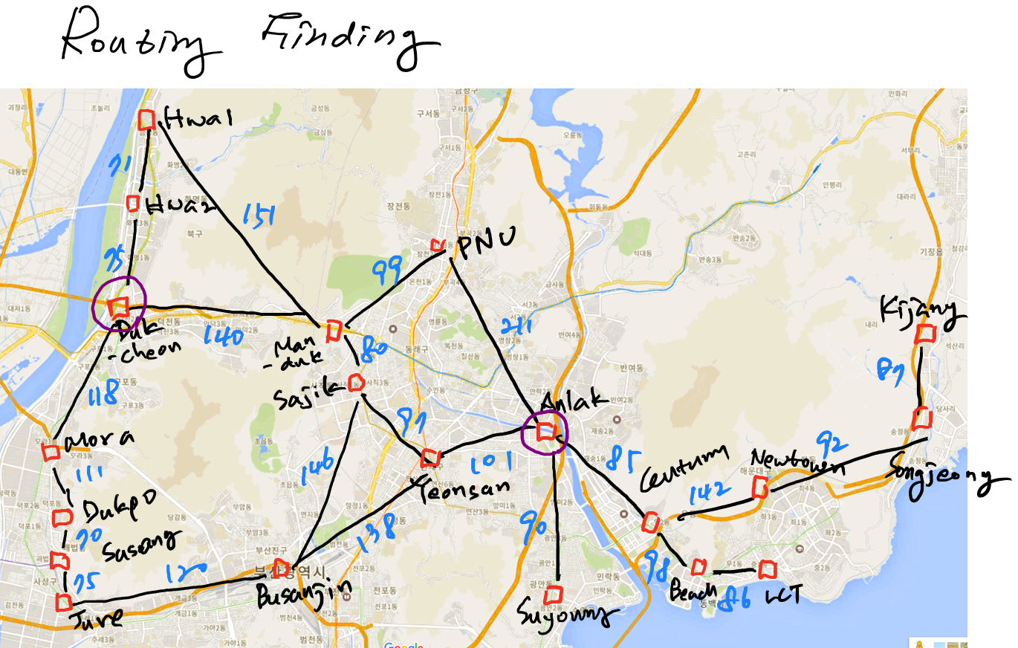
Motivation
BOM Tree

Slide 3
Outline
Graph and Tree Data Structure
Introduction
Abstract Data Type (ADT)
Graph
Graph ADT
Graph Traversal
Tree
Tree ADT
Tree Traversal
Dijkstra
Polynomial operation and Binary Tree Search
Huffman coding
Simple data compression using Huffman coding

Slide 4
Graph and Tree Data Structure
Introduction (1)
Some problem require certain data structure to be solved
Some problem is represented in graph are hard to be solved using just linear data structure explained previously
Example of problem: finding shortest path between two cities (we need information about all node/cities, feasible link between cities, and distance between cities)
Graph
A
B
C
A
B
C
A
B
C
LinkedList
Doubly LinkedList
D
E
Each node have information about next node (except last node)
Each node have information about previous and next node (except first and last node)
Each node may be has more than 2 connected node (node B and D)

Slide 5
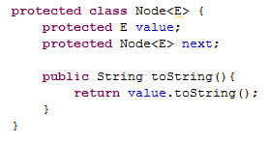
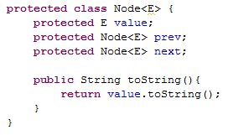
Graph and Tree Data Structure
Introduction (2)
Graph
A
B
C
A
B
C
LinkedList
Doubly LinkedList
A
B
C
code snippet
code snippet
D
Must be able to handle non linear data structure to represent connection of nodes
Adjacency matrix or adjacency list can be used to represent this kind of structure

Slide 6
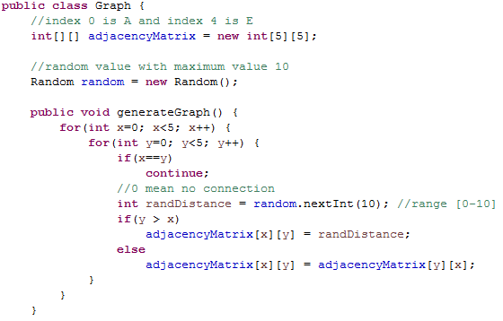

Graph and Tree Data Structure
Introduction (3)
Adjacency matrix is just matrix that keeping information about connection of node (vertices) with it neighborhood node where each value represents an edge and both the rows and the columns represent vertices
Adjacency list is just list that represented connection of node (vertices) with it neighborhood node that size can be dynamically
Graph
A
B
C
D
E
A
B
C
A
$$\begin{matrix}− & 2 & 1 & 3 & 1 \\ 2 & − & − & 1 & − \\ 1 & − & − & 4 & 1 \\ 3 & 1 & 4 & − & − \\ 1 & − & 1 & − & −\end{matrix}$$
B
C
E
D
D
E
Example of simple code
using adjacency matrix

Slide 7
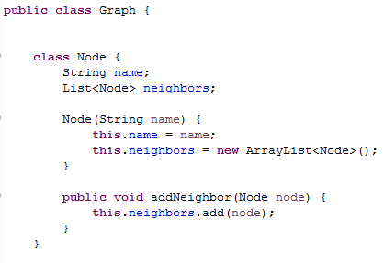
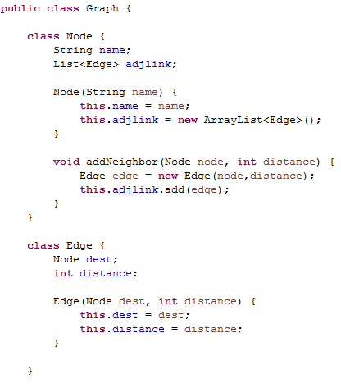
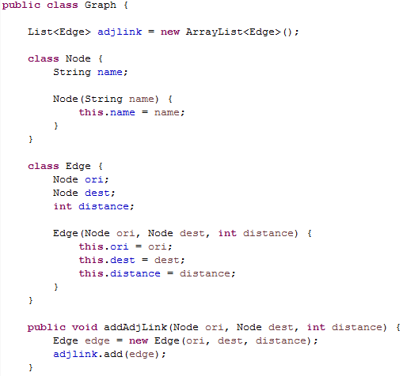
Graph and Tree Data Structure
Introduction (4)
data structure form is quite flexible
even adjacencyList can be implemented in several form of data structure
Adjacency list
without distance info
Adjacency list
with distance info
but edge put as
instance variable
Adjacency list
with distance info
but edge put in node

Slide 8
Graph and Tree Data Structure
Introduction (5)
Advantage of using adjacency matrix: amenable to mathematical manipulation, iteration over rows and columns correspond to computation on outlinks and inlinks (for directed graph)
Disadvantage of using adjacency matrix: lots of zeros for sparse matrix, lots of wasted place
Advantage of using adjacency list: much more compact representation, easy to compute over outlinks
Disadvantage of using adjacency list: much more difficult to compute over inlinks

Slide 9
Graph and Tree Data Structure
Abstract Data Type (ADT)
In the previous slide, we have seen snippet code of simple data structure. However to create better code that will showing good representation of data structure it better to use abstract data type (ADT). By using ADT we can hide the implementation details of data structure. In the java we usually code an ADT as an interface.
ADT can be described as a description of what a data structure should do for its user. It is list of operations are supposed to in our data structure.

Slide 10
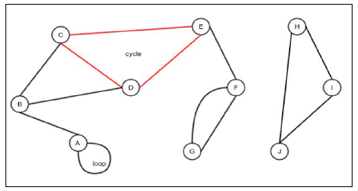
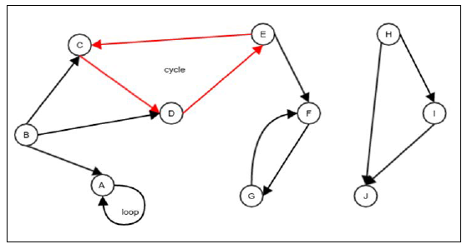
Graph and Tree Data Structure
Graph
Graph is collection of vertices and edges that connect the vertices. Graph is generalization of a tree (we will talk about tree later)
Graph can be undirected and directed
A path is sequence of edges that connects a set of vertices
A cycle is a path with at least two vertices involved, it starts and end on the same vertex
A loop is an edge that connects that connects a node to itself
Example of undirected graph
Example of directed graph

Slide 11
Graph and Tree Data Structure
Graph ADT (1)
We have to define what a data structure representing a graph should do. A graph must support following operations: add vertex, remove vertex, add edge, remove edge, is adjacent, neighbors, get vertex value, set vertex value, get edge value, set edge value, is undirected, get all vertices, max vertex id
Is adjacent: this to checks whether the two given vertices are adjacent to each other, that is, whether there is an edge between the given node
Neighbors: this returns a list of vertices that are adjacent to the given vertex
Is undirected: this to checks whether the graph is undirected or directed
Get all vertices: this returns a list containing all the vertices
Max vertex id: this returns the highest ID of the vertices

Slide 12
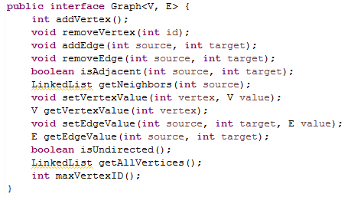
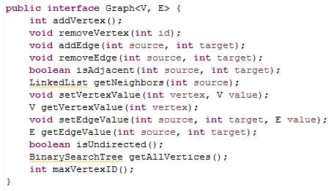
Graph and Tree Data Structure
Graph ADT (2)
2 interface below is showing example of graph ADT
Interface shown in the left and in the right have different return type for getAllVertices operations. This different return type influence searching performance after getting all vertices data
BinarySearchTree is just a class that we will search vertices more efficiently
Actually this ADT graph data structure is subjective
so you can modify it based on your preferences

Slide 13
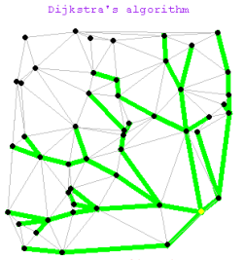

Dijkstra
Dijkstra algorithm is algorithm for finding the shortest paths between nodes in weighted graph. For unweighted graph that all edge have same value, BFS is preferable to use because for this situation BFS has running time less than Dijkstra
Dijkstra is conceived by computer scientist Edgar W Dijkstra
The algorithm exist in many variants: dijkstra original variant found the shortest path between two nodes
Weighted graph $G=(E,V)$
Sources vertex $s∈V to all vertices v ∈V$

Slide 14
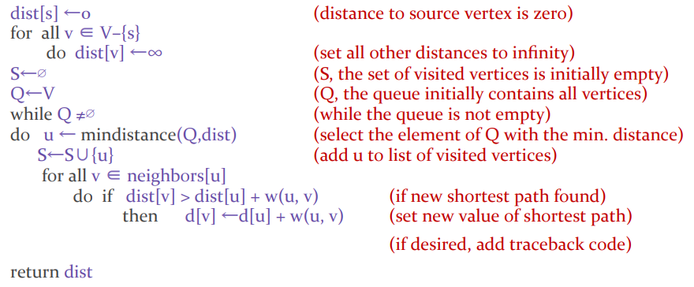
Dijkstra
Pseudocode of Dijkstra algorithm

Slide 15
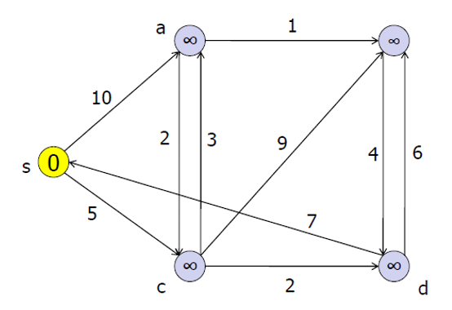
Dijkstra
Demo (1)
Q = {s,a,b,c,d}
S = {}
Dist_S_To = {(s,0), (a,∞), (b,∞), (c,∞), (d,∞)}
Predecessor = {(a,null), (b,null), (c,null), (d,null)}

Slide 16
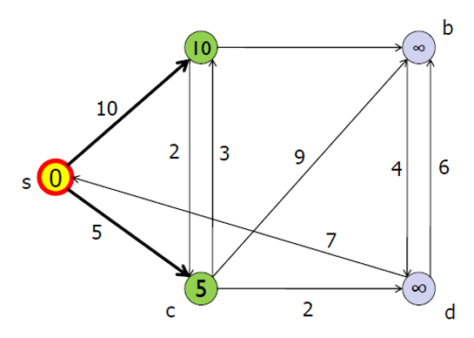
Dijkstra
Demo (2)
a
Q = {a,b,c,d}
S = {s}
Dist_S_To = {(a,10), (b,∞), (c,5), (d,∞)}
Predecessor = {(a,s), (b,null), (c,s), (d,null)}

Slide 17
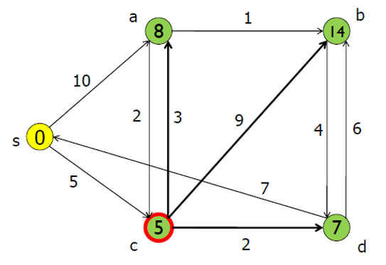
Dijkstra
Demo (3)
Q = {a,b,d}
S = {c,s}
Dist_S_To = {(a,8), (b,14), (c,5), (d,7)}
Predecessor = {(a,c), (b,c), (c,s), (d,c)}

Slide 18
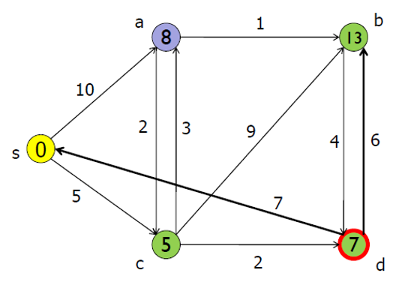
Dijkstra
Demo (4)
Q = {a,b}
S = {c,d,s}
Dist_S_To = {(s,0), (a,8), (b,13), (c,5), (d,7)}
Predecessor = {(a,c), (b,d), (c,s), (d,c)}

Slide 19
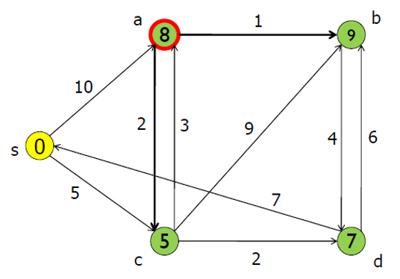
Dijkstra
Demo (5)
Q = {b}
S = {a,c,d,s}
Dist_S_To = {(s,0), (a,8), (b,9), (c,5), (d,7)}
Predecessor = {(a,c), (b,a), (c,s), (d,c)}

Slide 20
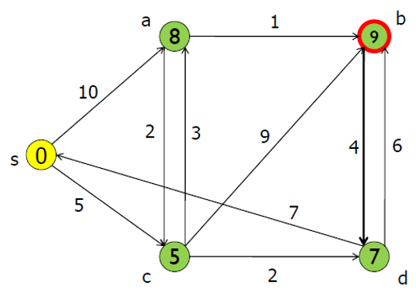
Dijkstra
Demo (6)
Q = {}
S = {a,b,c,d,s}
Dist_S_To = {(s,0), (a,8), (b,9), (c,5), (d,7)}
Predecessor = {(a,c), (b,a), (c,s), (d,c)}

Slide 21
Dijkstra
Demo (7)
After we get information above, we can determine any shortest path from the source node to any node in the graph by following predecessor set
Running time complexity for Dijkstra algorithm is O(V²) for matrix representation and O(E Log V) for adjacency list representation
Q = {}
S = {a,b,c,d,s}
Dist_S_To = {(a,8), (b,9), (c,5), (d,7)}
Predecessor = {(a,c), (b,a), (c,s), (d,c)}

Slide 22
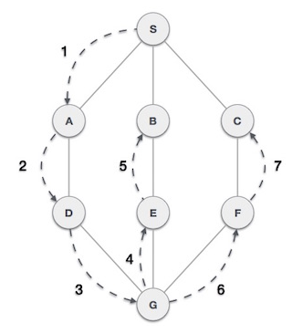
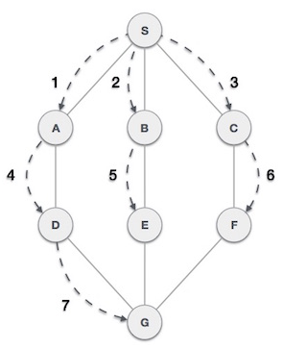
Graph and Tree Data Structure
Graph Traversal (1)
Graph Traversal is an algorithm to visit or to process all nodes of graph exactly one. Example algorithm that can be used for traversing a graph is deep-first-traversal and breadth-first-traversal
Depth-first-traversal or Depth-first-search (DFS) algorithm is a method for exploring a tree or graph. In a DFS, you go as deep as possible down one path before backing up and trying a different one
Example of DFS graph
Example of BFS graph

Slide 23
Graph and Tree Data Structure
Graph Traversal (2)
Breadth-first-traversal or Breadth-first-search (BFS) algorithm is a method for exploring a tree or graph. In a BFS, you first explore all the nodes one step away, then all the nodes two steps away, etc
Complexity for BFS and DFS in graph are same O(V+E) in adjacency list representation which V is number of vertex and E is number of edges
BFS and DFS need maintaining two collections of vertices: one that stores all the vertices that are discovered but are yet to be visited/explored and another that stores a Boolean array that checks whether a vertex has already been explored/visited
The collections of vertices that are discovered but yet to be explored can be of two types: if depth-first-traversal, we use Stack data structure, if breadth-fist-traversal, we use Queue data structure
DFS and BFS can be used to verified our graph structure

Slide 24
Graph and Tree
10
A
5
B
E
3
A
3
D
5
F
1
1
6
E
5
G
10
3
C
9
B
D
2
H
H
6
C
11
D
13
B
6
F
8
G
C
8
H
13
16
A
18
F
A
7
C
G
15
16
14
B
9
G
E
G
9
H
A
D
12
22
14
24
G
E
10
19
A
F
17
18
A
15
G
15
23

Slide 25
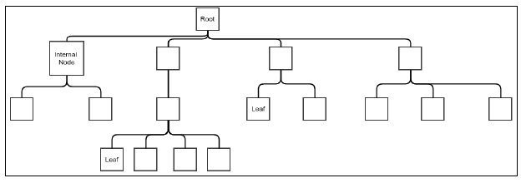
Graph and Tree Data Structure
Tree
A tree data structure looks very much like a real tree. A tree is generalization of linkedlist and special characteristic of graph.
While linkedlist node has one reference (doubly linkedlist has two reference) to the next node, a tree node has a reference to possibly more than one next node. These next node are called children of the node, and the node holding references to the children is called a parent node.
Node that don’t have any parent is called root
Special tree that only have two child in each parent node is called binary tree
Example of Tree

Slide 26
Tree ADT (§ 6.1.2)
We use positions to abstract nodes
Generic methods:
integer size()
boolean isEmpty()
Iterator elements()
Iterator positions()
Accessor methods:
position root()
position parent(p)
positionIterator children(p)
Query methods:
boolean isInternal(p)
boolean isExternal(p)
boolean isRoot(p)
Update method:
object replace (p, o)
Additional update methods may be defined by data structures implementing the Tree ADT

Slide 27
Preorder Traversal
A traversal visits the nodes of a tree in a systematic manner
In a preorder traversal, a node is visited before its descendants
Application: print a structured document
Algorithm preOrder(v)
visit(v)
for each child w of v
preorder (w)
1
Make Money Fast!
2
5
9
1. Motivations
2. Methods
References
3
4
6
7
8
2.1 Stock Fraud
2.2 Ponzi Scheme
2.3 Bank Robbery
1.1 Greed
1.2 Avidity

Slide 28
Postorder Traversal
In a postorder traversal, a node is visited after its descendants
Application: compute space used by files in a directory and its subdirectories
Algorithm postOrder(v)
for each child w of v
postOrder (w)
visit(v)
9
cs16/
8
3
7
homeworks/
programs/
todo.txt 1K
1
2
4
5
6
h1c.doc 3K
h1nc.doc 2K
DDR.java 10K
Stocks.java 25K
Robot.java 20K

Slide 29
Binary Trees (§ 6.3)
A binary tree is a tree with the following properties:
Each internal node has at most two children (exactly two for proper binary trees)
The children of a node are an ordered pair
We call the children of an internal node left child and right child
Alternative recursive definition: a binary tree is either
a tree consisting of a single node, or
a tree whose root has an ordered pair of children, each of which is a binary tree
Applications:
arithmetic expressions
decision processes
searching
A
B
C
D
E
F
G
H
I

Slide 30
Arithmetic Expression Tree
Binary tree associated with an arithmetic expression
internal nodes: operators
external nodes: operands
Example: arithmetic expression tree for the expression (2 × (a − 1) + (3 × b))
+
×
×
2
−
3
b
a
1

Slide 31
Decision Tree
Binary tree associated with a decision process
internal nodes: questions with yes/no answer
external nodes: decisions
Example: dining decision
Want a fast meal?
Yes
No
How about coffee?
On expense account?
Yes
No
Yes
No
Starbucks
Spike’s
Al Forno
Café Paragon

Slide 32
Properties of Proper Binary Trees
Notation
n number of nodes
e number of external nodes
i number of internal nodes
h height
Properties:
e = i + 1
n = 2e − 1
h ≤ i
h ≤ (n − 1)/2
e ≤ 2^{h}
h ≥ log₂ e
h ≥ log₂ (n + 1) − 1

Slide 33
BinaryTree ADT (§ 6.3.1)
The BinaryTree ADT extends the Tree ADT, i.e., it inherits all the methods of the Tree ADT
Additional methods:
position left(p)
position right(p)
boolean hasLeft(p)
boolean hasRight(p)
Update methods may be defined by data structures implementing the BinaryTree ADT

Slide 34
Inorder Traversal
In an inorder traversal a node is visited after its left subtree and before its right subtree
Application: draw a binary tree
x(v) = inorder rank of v
y(v) = depth of v
Algorithm inOrder(v)
if hasLeft (v)
inOrder (left (v))
visit(v)
if hasRight (v)
inOrder (right (v))
6
a
2
8
b
c
1
4
7
9
d
e
f
g
3
5
h
i

Slide 35
Print Arithmetic Expressions
Specialization of an inorder traversal
print operand or operator when visiting node
print “(“ before traversing left subtree
print “)“ after traversing right subtree
Algorithm printExpression(v)
if hasLeft (v) print(“(’’)
printExpression(left(v))
print(v.element ())
if hasRight (v)
printExpression(right(v))
print (“)’’)
+
×
×
2
−
3
b
((2 × (a − 1)) + (3 × b))
a
1

Slide 36
Evaluate Arithmetic Expressions
Specialization of a postorder traversal
recursive method returning the value of a subtree
when visiting an internal node, combine the values of the subtrees
Algorithm evalExpr(v)
if isExternal (v)
return v.element ()
else
x ← evalExpr(leftChild (v))
y ← evalExpr(rightChild (v))
◊ ← operator stored at v
return x ◊ y
+
×
×
2
−
3
2
5
1

Slide 37
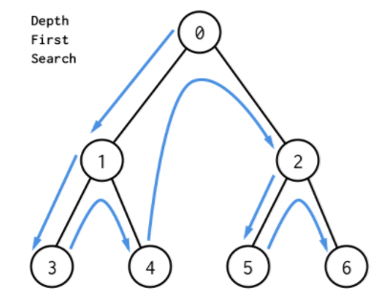
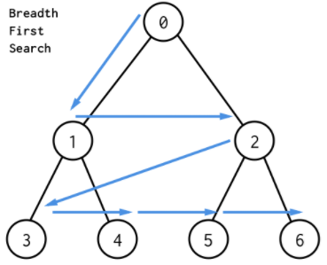
DFS vs. BFS in a tree
The different between DFS and BFS that conducted in tree and graph: in a tree, DFS and BFS always start from root node whereas in a graph, DFS and BFS can be started from any node (vertices)
Example of DFS tree
Example of BFS tree

Slide 38
PROCEDURE BreadthFirstSearch(Tree tree, Node root, Goal goal, List alreadyVisited)
Node current
Queue toVisit
add root to toVisit
while toVisit is not empty
current <- first node on toVisit
remove first node from toVisit
if current = goal
add current to alreadyVisited
return true
end if
for each child node C of current
add C to toVisit
end for
add current to alreadyVisited
end while

Slide 39
PROCEDURE DepthFirstSearch(Tree tree, Node root, Goal goal, List alreadyVisited)
Node current
Stack toVisit
add root to toVisit
while toVisit is not empty
current <- first node on toVisit
remove first node from toVisit
if current = goal
add current to alreadyVisited
return true
end if
for each child node C of current
add C to toVisit
end for
add current to alreadyVisited
end while

Slide 40
Linked Structure for Trees
A node is represented by an object storing
Element
Parent node
Sequence of children nodes
Node objects implement the Position ADT
∅
B
∅
∅
A
D
F
B
A
D
F
C
E
∅
∅
C
E

Slide 41
Linked Structure for Binary Trees
A node is represented by an object storing
Element
Parent node
Left child node
Right child node
Node objects implement the Position ADT
∅
B
∅
∅
B
A
D
A
D
∅
∅
∅
∅
C
E
C
E

Slide 42
Array-Based Representation of Binary Trees
nodes are stored in an array
1
A
…
2
3
B
D
let rank(node) be defined as follows:
rank(root) = 1
if node is the left child of parent(node), rank(node) = 2*rank(parent(node))
if node is the right child of parent(node), rank(node) = 2*rank(parent(node))+1
4
5
6
7
E
F
C
J
10
11
G
H

Slide 43
Huffman Coding
Introduction
Huffman coding is proposed by Dr. David Huffman in 1952
Basic algorithm of Huffman coding:
Huffman coding is a form of statistical coding
Not all characters occur with the same frequency
Yet all characters are allocated the same amount of space
There are mainly two major parts in Huffman coding
Build a Huffman tree from input characters
Traverse the Huffman tree and assign codes to characters

Slide 44
Huffman Coding
Steps to build Huffman Tree
Input is array of unique characters along with their frequency of occurrences and output is Huffman Tree
Create a leaf node for each unique character and build a min heap of all leaf nodes (min heap is used as priority queue. The value of frequency field is used to compare two nodes in min heap. Initially the least frequent character is at root)
Extract two nodes with the minimum frequency from the min heap
Create a new internal node with frequency equal to the sum of the two nodes frequencies. Make the first extracted node as its left child and the other extracted node as its right child. Add this node to the min heap
Repeat step 3 and 4 until the heap contains only one node. The remaining node is the root node and the tree is complete

Slide 45
Encoding
A code is a mapping of each character of an alphabet to a binary code-word
A prefix code is a binary code such that no code-word is the prefix of another code-word
An encoding trie represents a prefix code
Each leaf stores a character
The code word of a character is given by the path from the root to the leaf storing the character (0 for a left child and 1 for a right child
00 | 010 | 011 | 10 | 11
a | b | c | d | e
a
d
e
b
c

Slide 46
Encoding
Given a text string X, we want to find a prefix code for the characters of X that yields a small encoding for X
Frequent characters should have short code-words
Rare characters should have long code-words
Example
X = abracadabra
T₁ encodes X into 29 bits
T₂ encodes X into 24 bits
T₁
T₂
c
d
b
a
b
r
a
r
c
d

Slide 47
Huffman’s Algorithm
Algorithm HuffmanEncoding(X)
Input string X of size n
Output optimal encoding trie for X
C ← distinctCharacters(X)
computeFrequencies(C, X)
Q ← new empty heap
for all c ∈ C
T ← new single-node tree storing c
Q.insert(getFrequency(c), T)
while Q.size() > 1
f₁ ← Q.min()
T₁ ← Q.removeMin()
f₂ ← Q.min()
T₂ ← Q.removeMin()
T ← join(T₁, T₂)
Q.insert(f₁ + f₂, T)
return Q.removeMin()
Given a string X, Huffman’s algorithm construct a prefix code the minimizes the size of the encoding of X
It runs in time O(n + d log d), where n is the size of X and d is the number of distinct characters of X
A heap-based priority queue is used as an auxiliary structure

Slide 48
Example
11
X = abracadabra
a
6
Frequencies
2
4
a | b | c | d | r
5 | 2 | 1 | 1 | 2
c
d
b
r
6
2
4
a
b
c
d
r
5
2
1
1
2
a
c
d
b
r
5
2
2
4
a
b
c
d
r
a
c
d
b
r
5
2
2
5

Slide 49
Graph and Tree
Consider following picture represented motorcycle bill of material structure. How do we store this kind of data in memory using java programming language? Can we trace hierarchy of data (down and up) as shown in the picture?

Slide 50
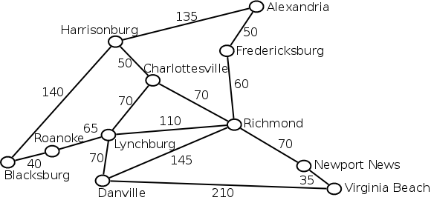
Graph and Tree
Consider graph below represented connection and distance between cities. How do we store this kind of data in memory using java programming language? Can we harness this kind of data representation to solve optimization problem like finding the shortest path between two cities?

Slide 51
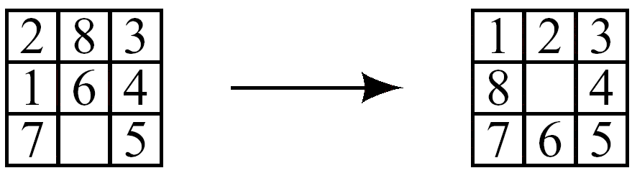
Puzzle
e.g.) 8-puzzle problem
state description
3-by-3 array: each cell contains one of 1-8 or blank symbol
two state transition descriptions
8×4 moves: one of 1-8 numbers moves up, down, right, or left
4 moves: one black symbol moves up, down, right, or left
How many states are there?
State space for 8-puzzle is
Divided into two separate graphs : not reachable from each other

